Slide 1
06 | Deployment and Next Steps
Susan Ibach | Developer Evangelist
Christopher Harrison | Content Developer

Slide 2
Module Overview
Bootstrap
Ensuring consistency
Deploying to Azure
Setting up the database
Setting up the website
Where do we go from here?

Slide 3
Ensuring consistency

Slide 4
Templates and blocks in action
Music Store
Music Store
Music Store
Link
Link
Link
Link
Block
(Placeholder)
Link
Link
Link
Link
Artist:
Year:
Link
Link
Link
Link
Artist:
Year:
Layout.html
ArtistDetails.html
What the user sees

Slide 5
The base template (or parent)
Logo HTML
Music Store
{% block blockName %}
default content (optional)
{% endblock %}
Link
Link
Link
Link
Block
(Placeholder)
Navigation links HTML
Layout.html

Slide 6
The content page (or child)
{% extends "baseName.html" %}
Music Store
Link
Link
Link
Link
Artist:
Year:
{% block blockName %}
Content to display
{% endblock %}
ArtistDetails.html

Slide 7
Using layouts

Slide 8
Bootstrap (in 5 minutes...)

Slide 9
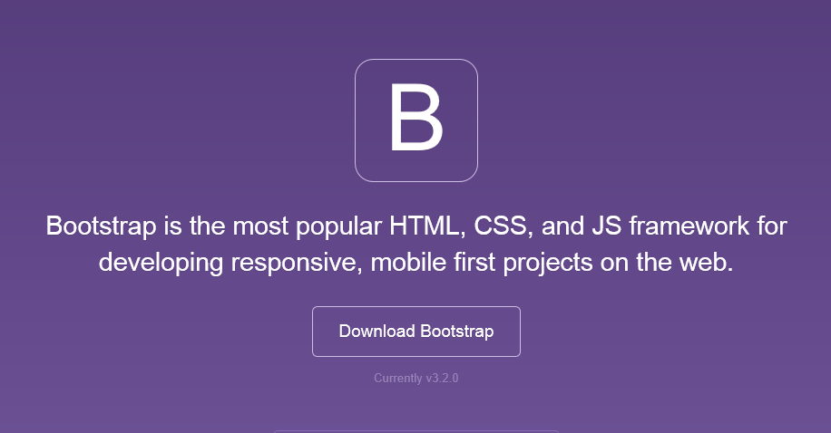
Bootstrap

Slide 10
Why bother with Bootstrap?
CSS can be tricky
Cross browser support can be a challenge
Solves basic tasks (e.g. page layout without tables)

Slide 11
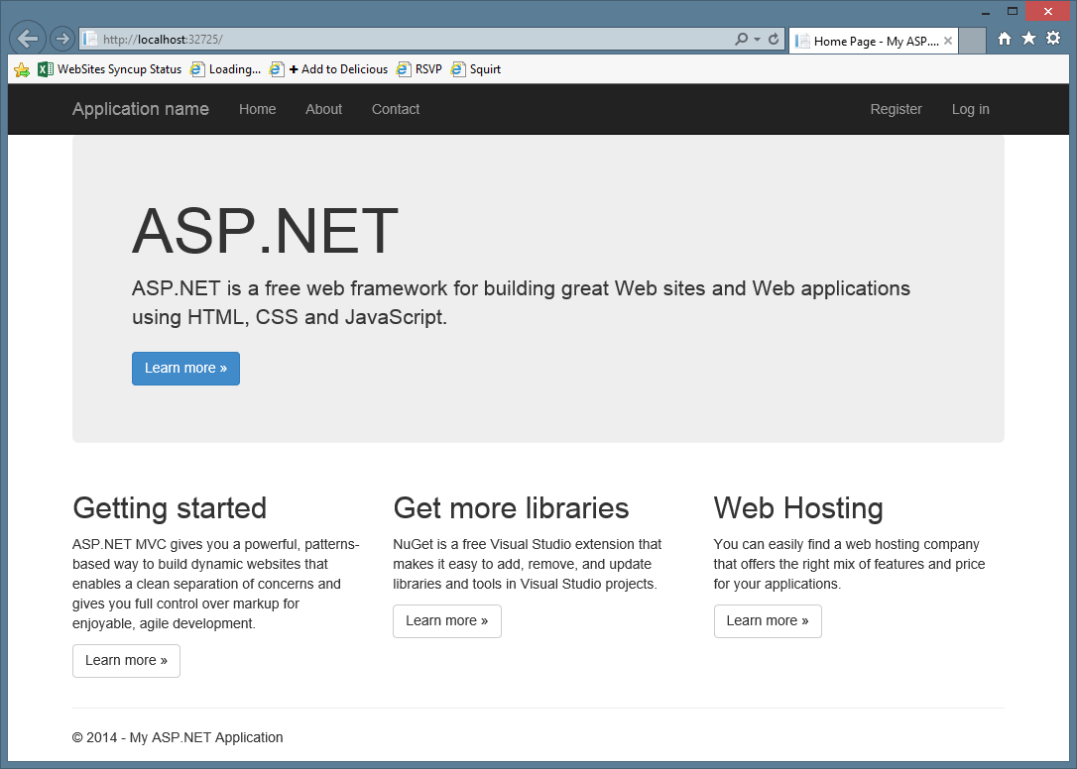
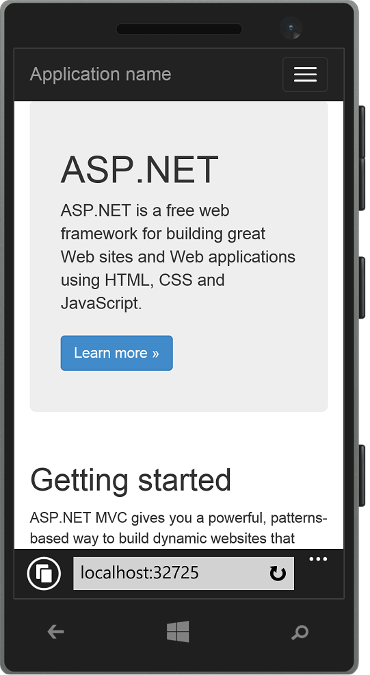
Responsive layout examples

Slide 12
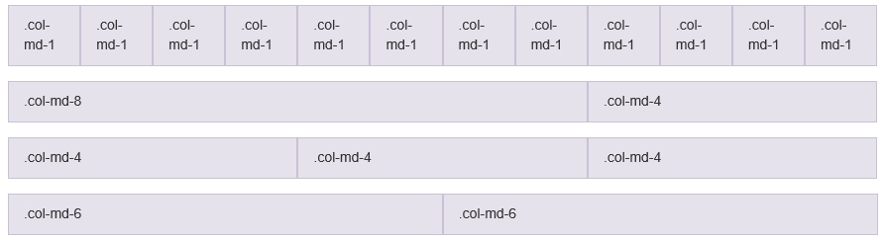
Sizing your content

Slide 13
Four grids to rule them all One for each size of device
Large (lg)
Medium (md)
Small (sm)
Extra Small (xs)

Slide 14
Using Bootstrap

Slide 15
Deploying to Azure

Slide 16
It's time to take our site public
So what do we need?
Web server that's publicly accessible
Database that's accessible to our web server

Slide 17
Lots of possible solutions
Host your own
Cloud services
Azure
AWS
Many others available

Slide 18
Azure can host your application
Regardless of what language you want to use
Regardless of what tools you want to use
Regardless of what database you want to use

Slide 19
Deployment overview
Create the database
Update the application to use the database
Create the web site
Upload the application to the server

Slide 20
Setting up the database

Slide 21
What database should we choose?
Azure supports most databases
Microsoft SQL Server
MySQL
Oracle
Django supports most databases
Microsoft SQL Server
MySQL
Oracle

Slide 22
What database should you choose?
Often a matter of preference
In our case, we'll stick with OSS and go with MySQL

Slide 23
Creating a MySQL Database

Slide 24
What about our database structure?
We created a database using Django's ORM solution
How do we get our new MySQL database set up?

Slide 25
As it turns out...
We do it the exact same way
python manage.py migrate
We need to update our application to point to the new database
Retrieve the connection information from Azure
Update settings.py

Slide 26
Configuring our application to use MySQL

Slide 27
Creating a web site

Slide 28
Azure makes it easy to create a website
Can go through the Azure UI
Can create the site from Visual Studio

Slide 29
Creating a website on Azure

Slide 30
Where do we go from here?

Slide 31
Next steps...
Learn more about Django
Django documentation
Learn more about Bootstrap
MVA
edX

